Slide 1

CREDIT CARD CLUSTERING
SHAI for AI

Slide 2

AGENDA
INTRODUCTION
ANALYSIS
PREPROCESSING
ALGORITHMS USED
RESULTS

Slide 3

INTRODUCTION
In this project, trying to explore a dataset that summarizes the usage behavior of approximately 9,000 active credit card holders over the last 6 months. The dataset contains 17 behavioral variables at the customer level.

Slide 4
DATA OVERVIEW
CUST_ID: Customer ID
BALANCE: Balance amount left in the account
BALANCE_FREQUENCY: How frequently the balance is updated
PURCHASES: Total amount of purchases made
ONEOFF_PURCHASES: Amount of one-off purchases
INSTALLMENTS_PURCHASES: Amount of installment purchases
CASH_ADVANCE: Cash advance taken from the account
PURCHASES_FREQUENCY: Frequency of purchases
ONEOFF_PURCHASES_FREQUENCY: Frequency of one-off purchases
PURCHASES_INSTALLMENTS_FREQUENCY: Frequency of installment purchases
CASH_ADVANCE_FREQUENCY: Frequency of cash advances
CASH_ADVANCE_TRX: Number of transactions for cash advances
PURCHASES_TRX: Number of purchase transactions
CREDIT_LIMIT: Credit limit on the account
PAYMENTS: Total payments made
MINIMUM_PAYMENTS: Minimum payments due
PRC_FULL_PAYMENT: Percentage of full payment
TENURE: Number of months as a customer

Slide 5

EDA
LET’S DIVE IN

Slide 6
Dataset has 8950 rows and 17 columns.
Numeric columns in the dataset: ‘BALANCE’, ‘BALANCE_FREQUENCY’, ‘PURCHASES’, ‘ONEOFF_PURCHASES’, ‘INSTALLMENTS_PURCHASES’, ‘CASH_ADVANCE’, ‘PURCHASES_FREQUENCY’, ‘ONEOFF_PURCHASES_FREQUENCY’, ‘PURCHASES_INSTALLMENTS_FREQUENCY’, ‘CASH_ADVANCE_FREQUENCY’, ‘CASH_ADVANCE_TRX’, ‘PURCHASES_TRX’, ‘CREDIT_LIMIT’, ‘PAYMENTS’, ‘MINIMUM_PAYMENTS’, ‘PRC_FULL_PAYMENT’, ‘TENURE’.
‘CREDIT_LIMIT’ has 1 null value and ‘MINIMUM_PAYMENTS’ has 313 null values.
No duplicate rows in the dataset.

Slide 7
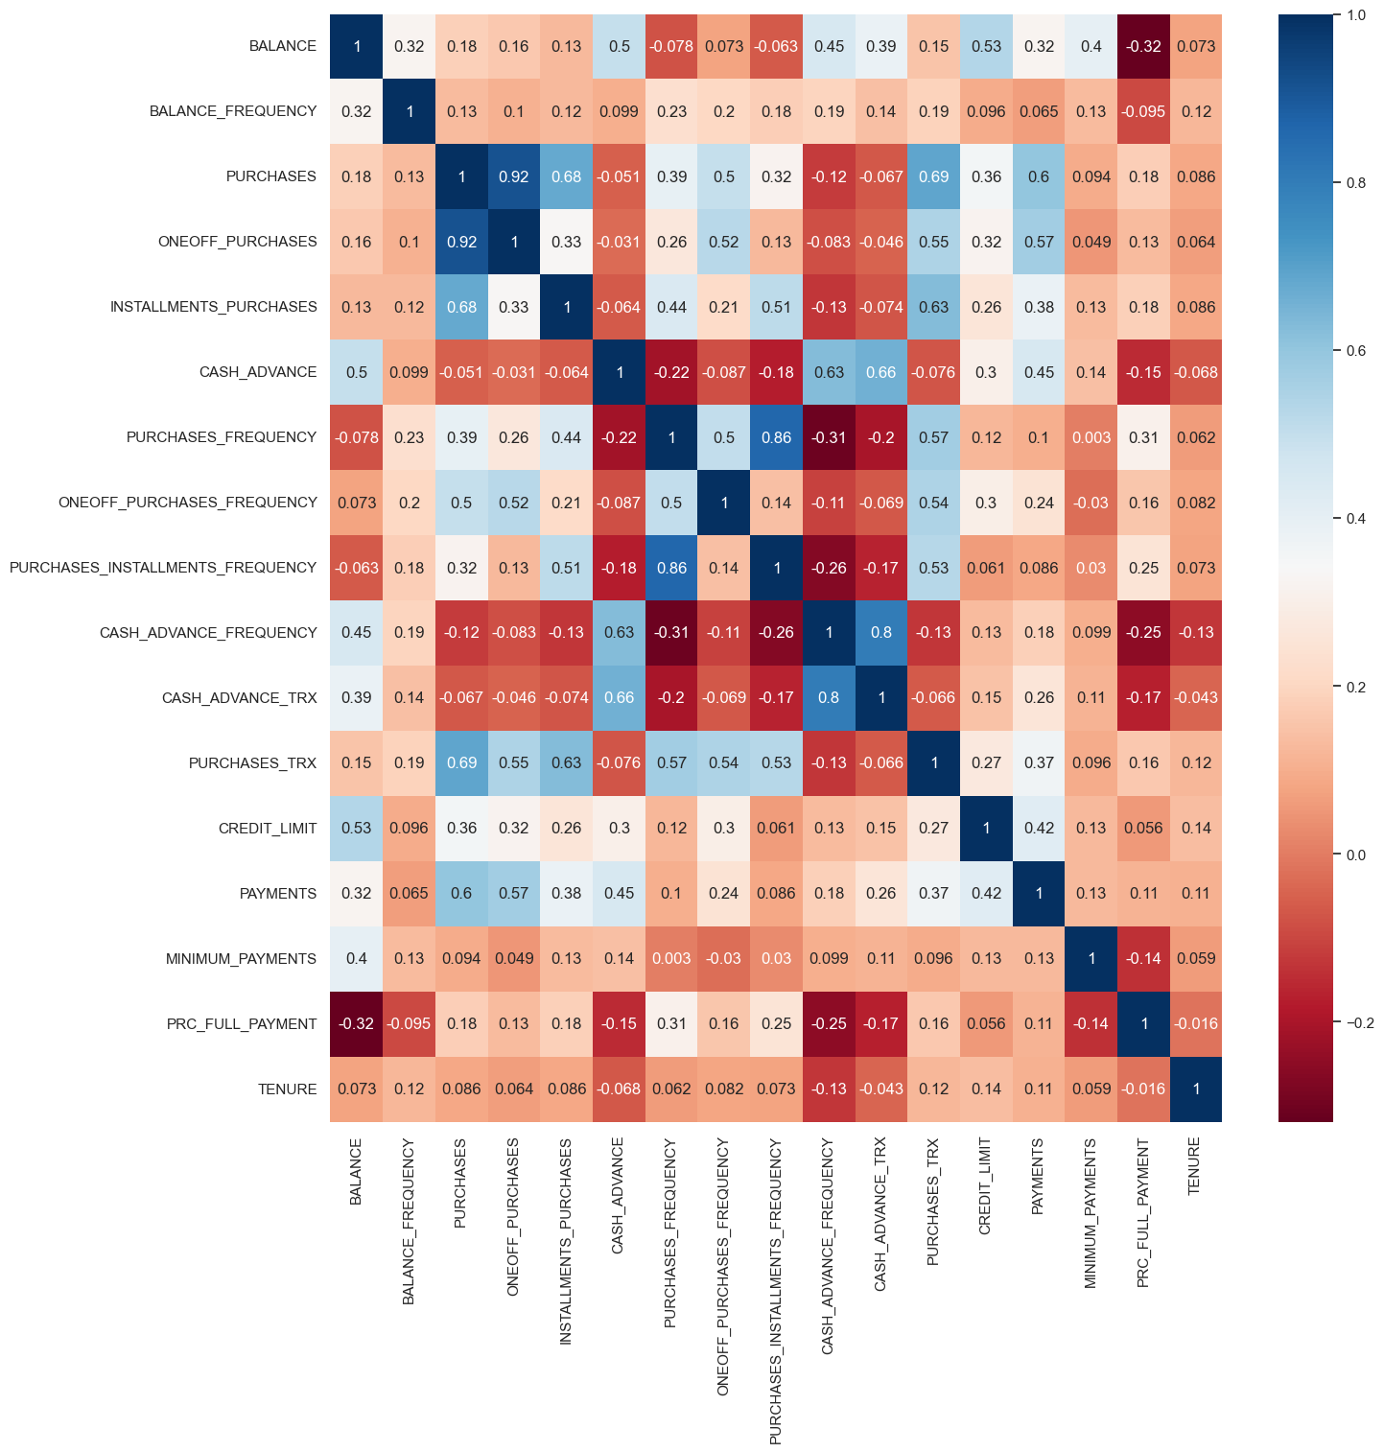
HEAT MAP: FOR CORRELATION

Slide 8
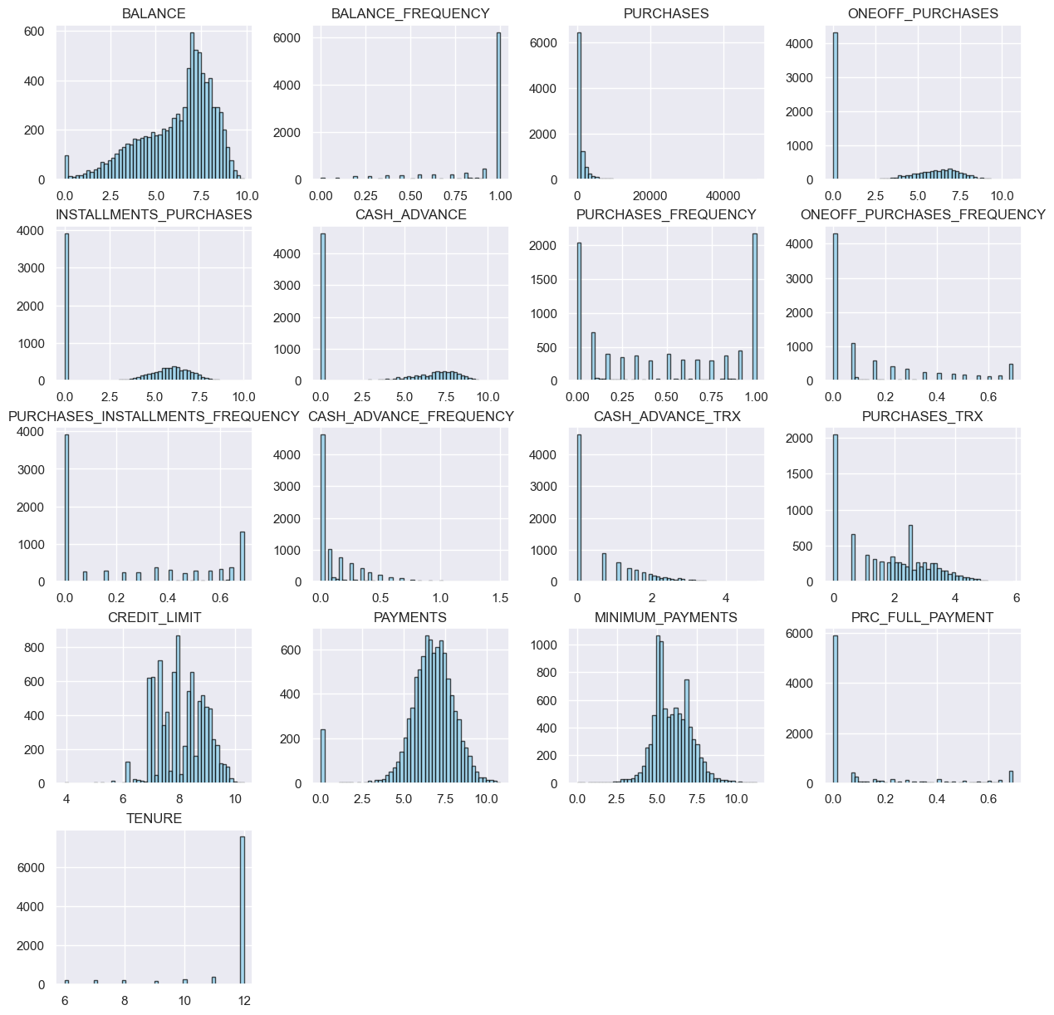
HISTOGRAMS, EACH REPRESENTING A DIFFERENT FINANCIAL ATTRIBUTE.

Slide 9
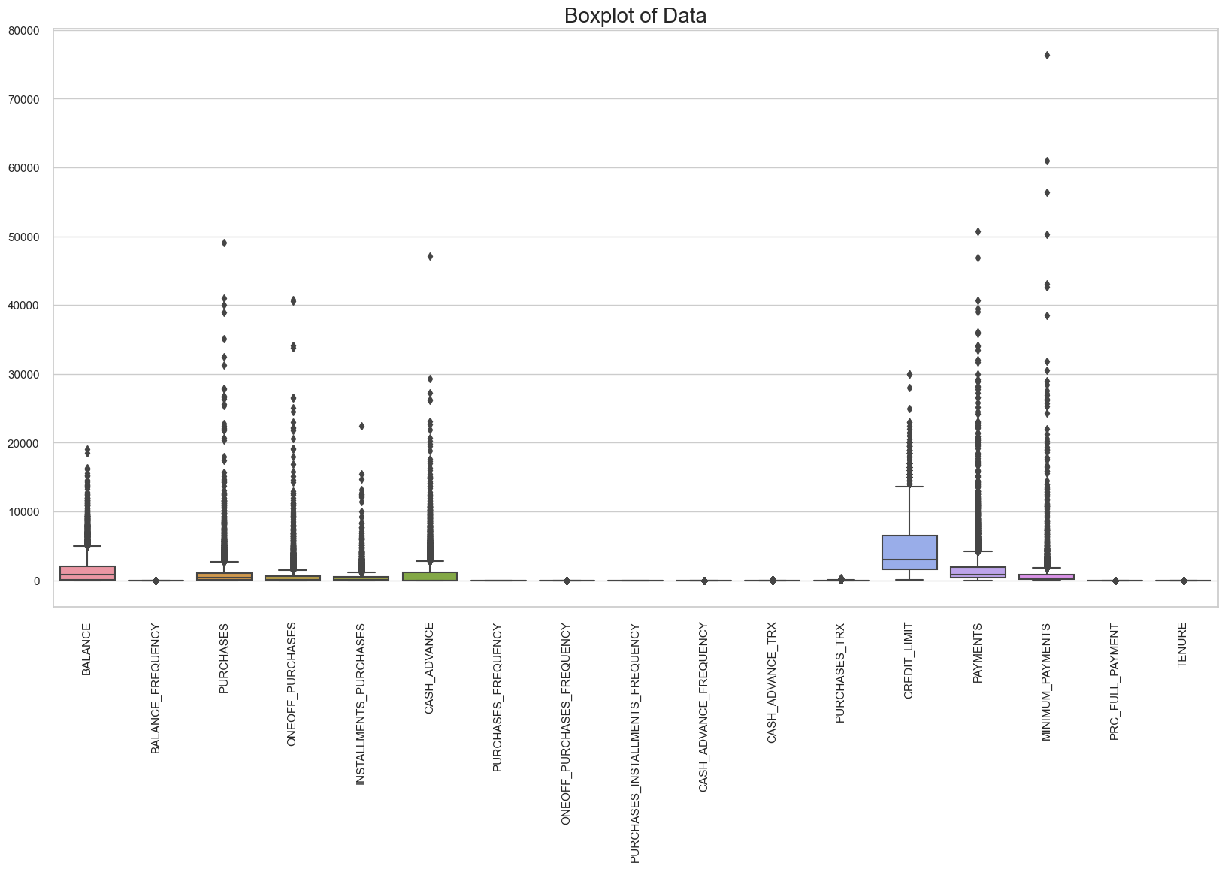
BOX PLOT, EACH REPRESENTING A DIFFERENT FINANCIAL ATTRIBUTE SHOWS THAT WE HAVE OUTLIERS.

Slide 10
PREPROCESSING
LET’S DIVE IN

Slide 11
1. The k-nearest neighbors imputer (knnimputer) is used to fill in missing values in the ‘MINIMUM_PAYMENTS’ column. This method finds the 3 nearest neighbors and uses their values to impute the missing data. 2. The median of the ‘CREDIT_LIMIT’ column is used to fill in its missing values. The median is a robust measure that is not affected by outliers. 3. A logarithmic transformation is applied to several columns to reduce the skewness of the data. This can help to normalize the data and make it more suitable for certain statistical analyses. 4.The quantile transformer is used to transform the data to follow a normal distribution. This can help to normalize the data and make it more suitable for certain statistical analyses. 5. Using principal component analysis (PCA) for dimensionality reduction process, to reduce the complexity of the data, improve model performance, and help with visualization
Preprocessing steps:

Slide 12
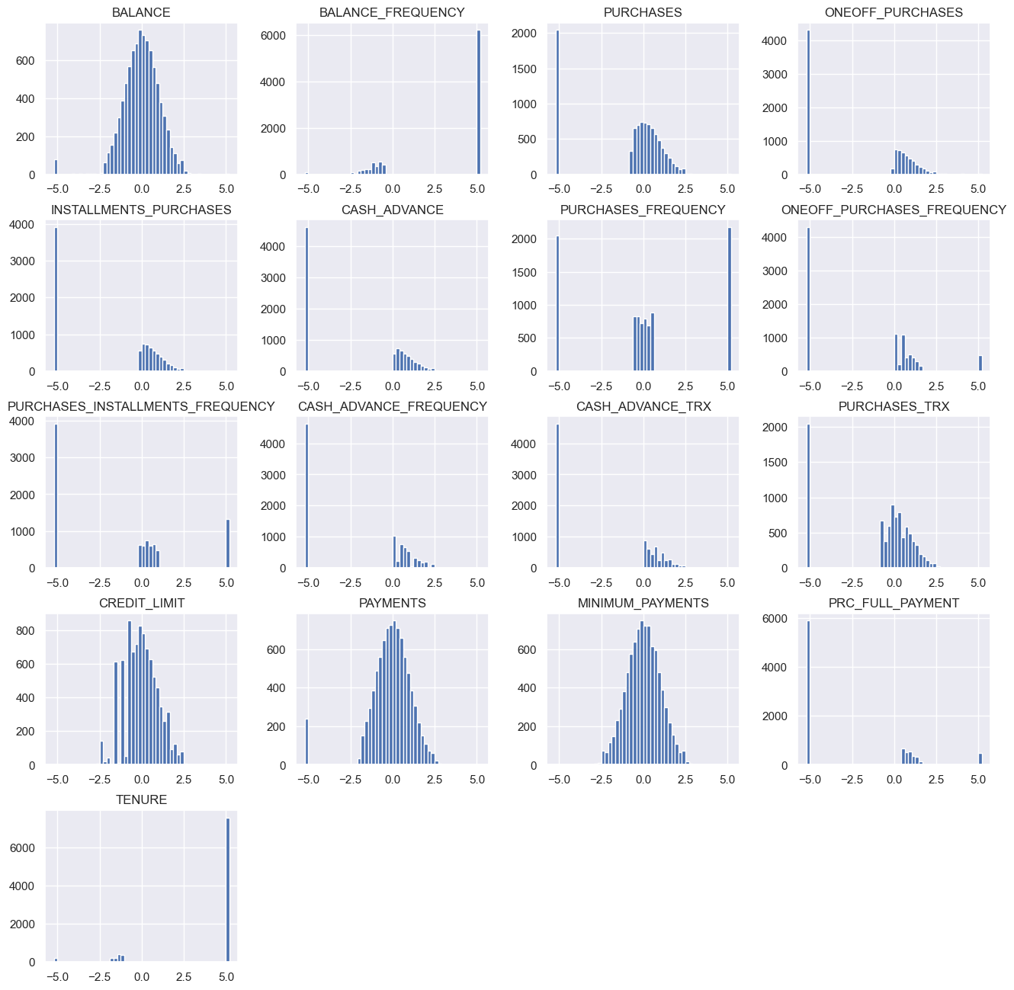
AFTER PREPROCESSING

Slide 13
CLUSTERING MODELS
LET’S DIVE IN

Slide 14
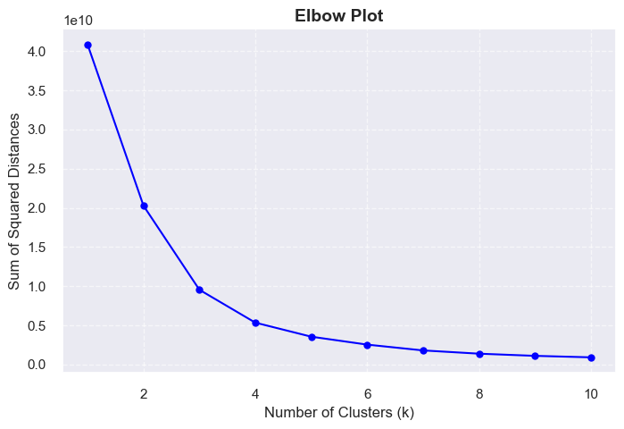
CHOOSING CLUSTER BASED ON ELBOW METHOD W

Slide 15
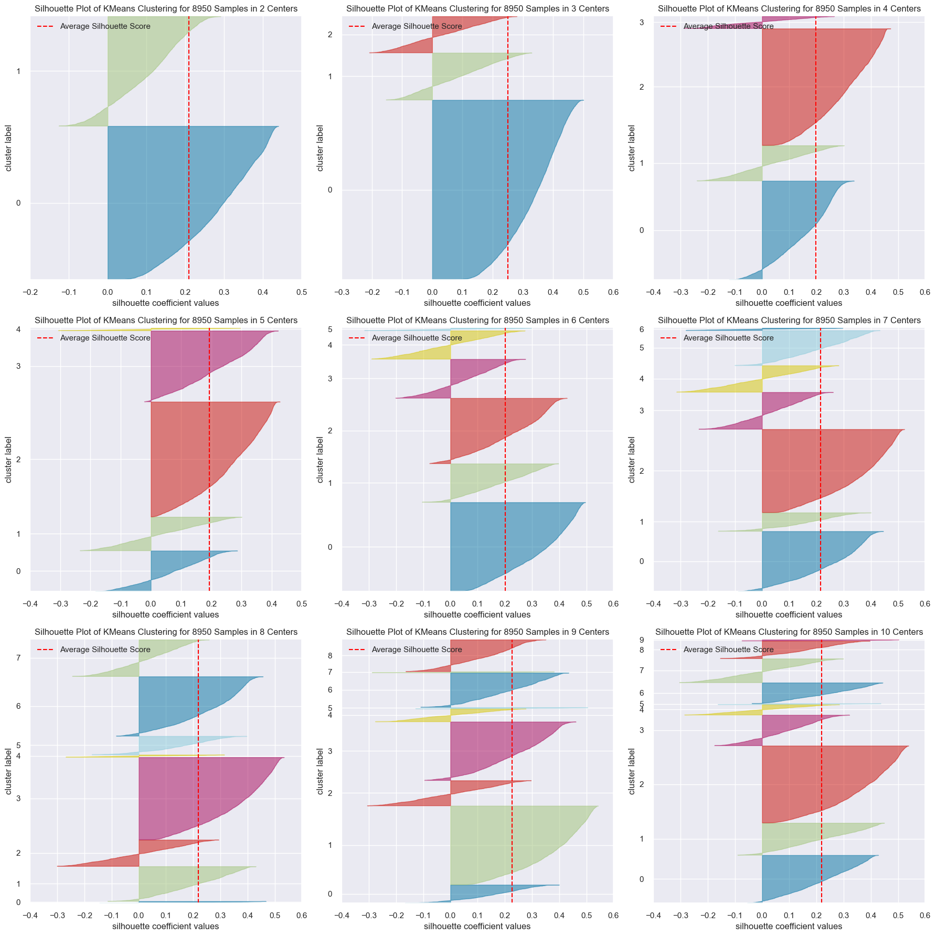
CREATING SILHOUETTE PLOTS FOR KMEANS CLUSTERING WITH A DIFFERENT NUMBER OF CLUSTER TO DETERMINE THE OPTIMAL NUMBER OF CLUSTERS FOR KMEANS. THE OPTIMAL NUMBER OF CLUSTERS IS TYPICALLY CONSIDERED TO BE THE ONE WITH THE HIGHEST AVERAGE SILHOUETTE SCORES WHICH IS 3 CLUSTERS

Slide 16
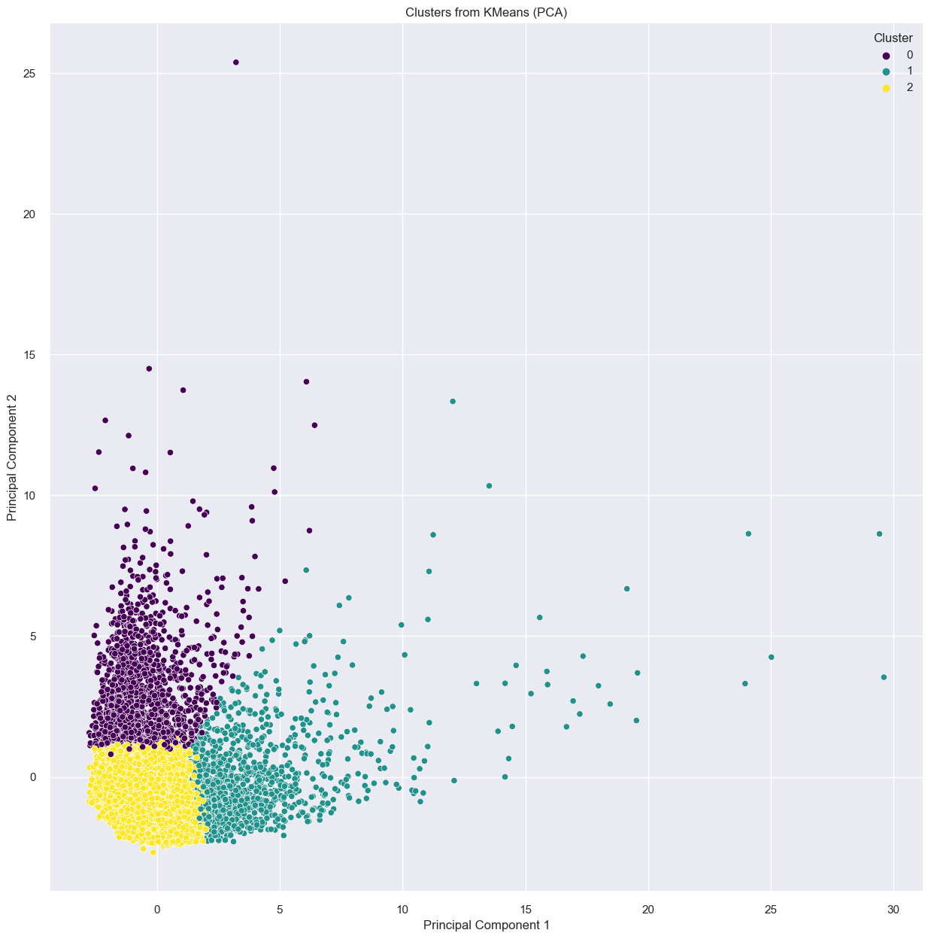
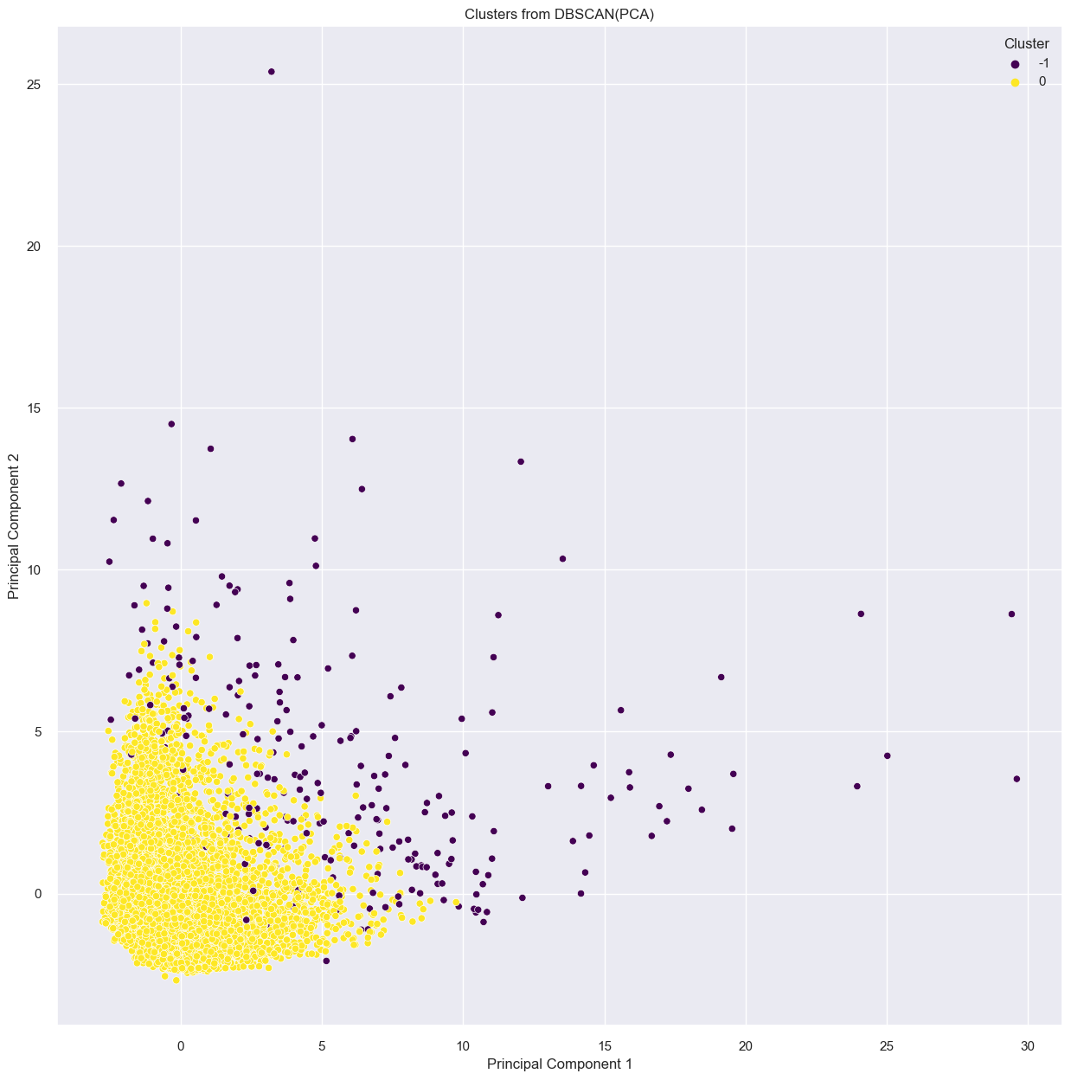
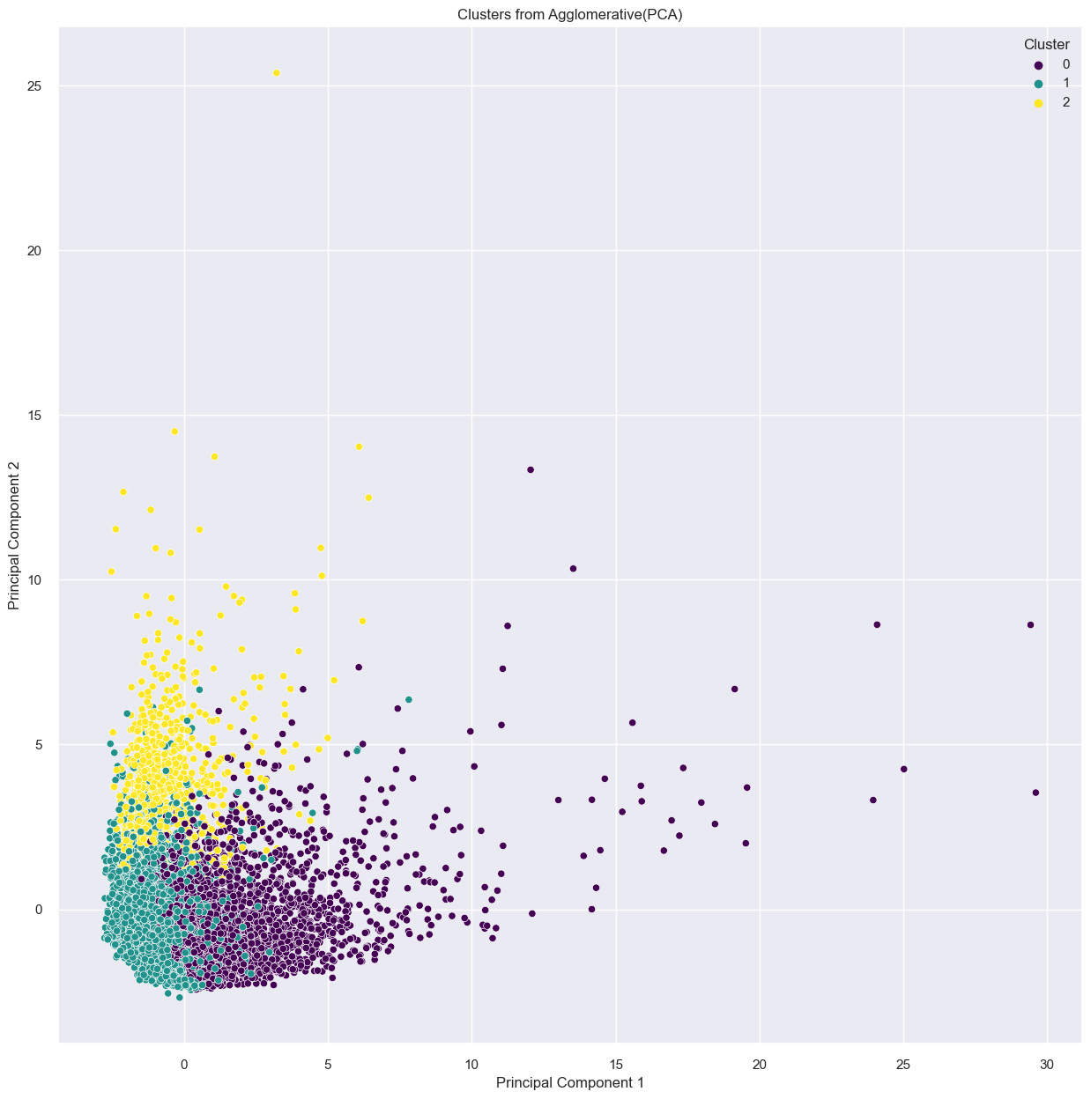
UNSUPERVISED ALGORITHMS THAT WERE USED
Silhouette Score: 0.251
Davies-Bouldin Index: 1.597
Silhouette Score: 0.614
Davies-Bouldin Index: 1.713
Silhouette Score: 0.173
Davies-Bouldin Index: 1.798
Silhouette score of model using PCA is 0.798
Davies Bouldin score of model using PCA is 0.457
Silhouette score of model using PCA is -0.16
Davies Bouldin score of model using PCA is 3.55
Silhouette score of model using PCA is 0.94
Davies Bouldin score of model using PCA is 0.37

Slide 17
THANK YOU

